Slide 1
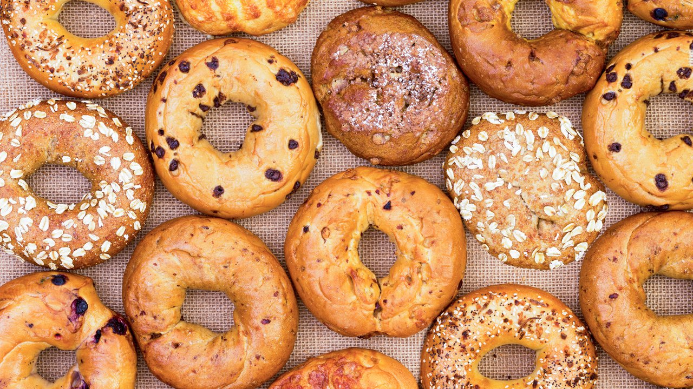
Ad Bid for Online Auction
Root Insurance Challenge
Patrick Vallely (Ohio State), Robert Palmere (Rutgers), Yujie Qian (Yale), Inhee Lee (Ohio State)
Building an optimal bid strategy
https://github.com/rdp135/Root_Insurance
May 2021 Data Science Bootcamp

Slide 2
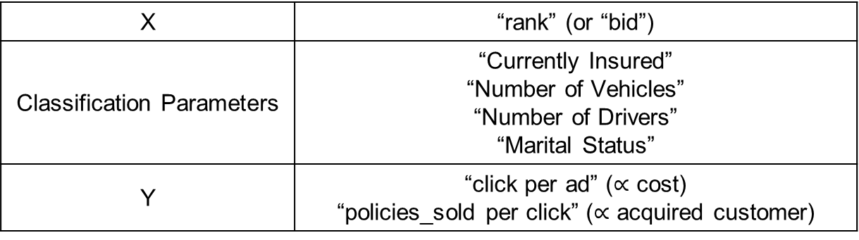
Problem Set and Data Description (Example)
What is the “bidding strategy” for
optimizing (minimizing) the cost per customer
at least 400 customers acquired for every 10,000 ads
Data Set
X | “rank” (or “bid”)
Classification Parameters | “Currently Insured” “Number of Vehicles” “Number of Drivers” “Marital Status”
Y | “click per ad” ($∝$ cost) “policies_sold per click” ($∝$ acquired customer)
May 2021 Data Science Bootcamp

Slide 3
Our Approach and Teamwork
Initial Data Scratch [Patrick]
Approach 1: Random Walk Method [Patrick]
Approach 2: Bid Optimization using Poisson Distribution [Inhee]
Approach 3: Real Time Bid Strategy [Robert]
Robustness Check [Yujie]
May 2021 Data Science Bootcamp

Slide 4
Explanatory Data Analysis (One Example)
Ad Rank Placement Drives Clicks, Not Sales.
May 2021 Data Science Bootcamp

Slide 5
Approach 1 Discussion
In the presentation, make sure you mention WHY you used each method and understand the purposes/limitations of your methodological approach compared to others. (an answer of “this method gave me the highest accuracy” may be troubling to the judges)
In the presentation, make sure you mention how and WHY you selected your performance metric (e.g., why focus on accuracy but not recall?) so the judges know that you understand which metrics are appropriate for your specific project
May 2021 Data Science Bootcamp

Slide 6
Approach 1 Key Results
May 2021 Data Science Bootcamp

Slide 7
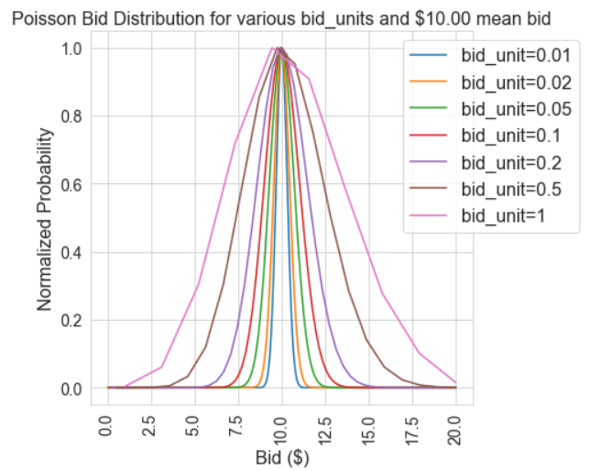
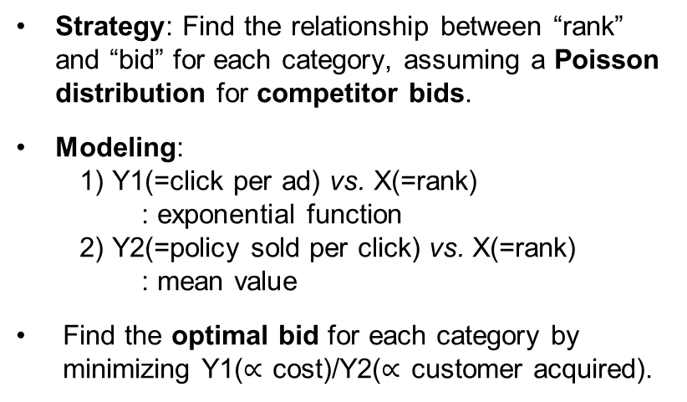
Approach 2: Bid Optimization using Poisson Distribution
?
no information of relationship between “bid” and “rank”
bid
rank
Strategy: Find the relationship between “rank” and “bid” for each category, assuming a Poisson distribution for competitor bids.
Modeling:
1) Y1(=click per ad) vs. X(=rank)
: exponential function
2) Y2(=policy sold per click) vs. X(=rank)
: mean value
Find the optimal bid for each category by minimizing Y1($∝$ cost)/Y2($∝$ customer acquired).
May 2021 Data Science Bootcamp

Slide 8
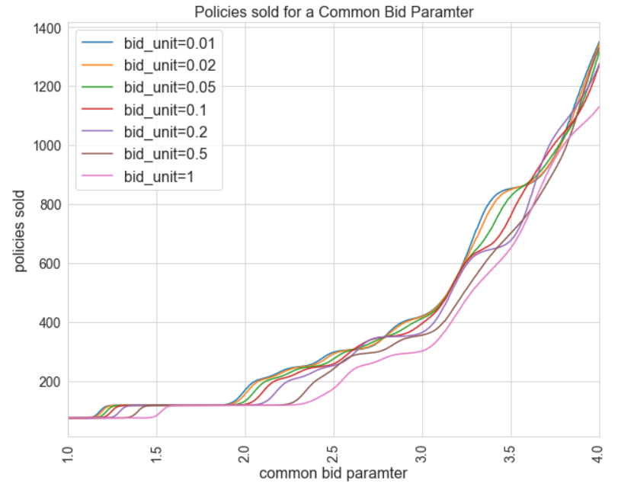
Policies Sold for a Common Bid Parameter
We use a common bid parameter representing the common cost for each category.
Later we convert common bid parameter to the actual bid for each category, reflecting the weight of Y2(= policies sold per click).
May 2021 Data Science Bootcamp

Slide 9
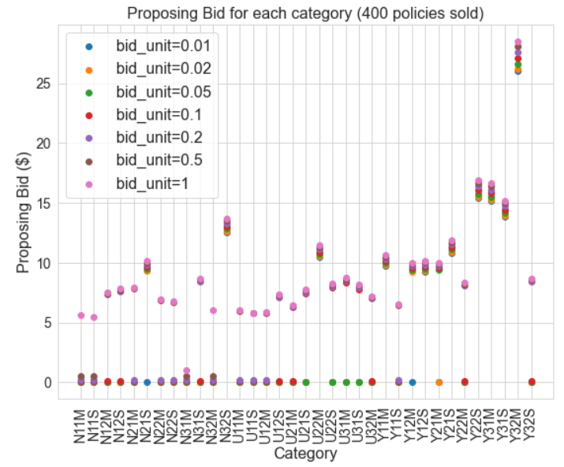
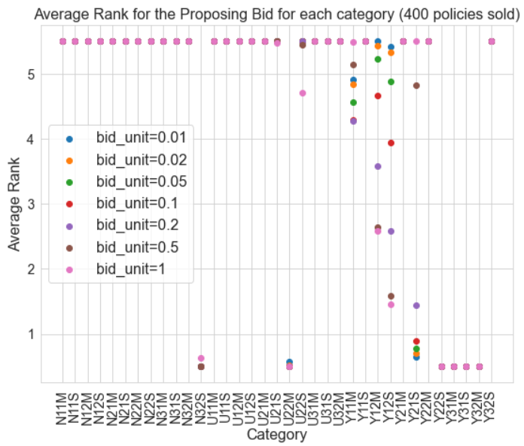
Proposing Bid for Each Category
May 2021 Data Science Bootcamp

Slide 10
Approach 3 Discussion
In the presentation, make sure you mention WHY you used each method and understand the purposes/limitations of your methodological approach compared to others. (an answer of “this method gave me the highest accuracy” may be troubling to the judges)
In the presentation, make sure you mention how and WHY you selected your performance metric (e.g., why focus on accuracy but not recall?) so the judges know that you understand which metrics are appropriate for your specific project
May 2021 Data Science Bootcamp

Slide 11
Approach 3 Key Results
May 2021 Data Science Bootcamp

Slide 12
Conclusion
May 2021 Data Science Bootcamp

Slide 13
Thank You!
TEAM 19 Heliodor: Ad Bid for Online Auction
https://github.com/rdp135/Root_Insurance
Patrick Valley
vallely.7@osu.edu
Ohio State University
Robert Palmere
rdp135@chem.rutgers.edu
Tri-State University
Yujie Qian
yujie.qian@yale.edu
Yale University
Inhee Lee
lee.2338@osu.edu
Ohio State University
May 2021 Data Science Bootcamp

